Slide 1

INTRODUCTION TO MATLAB
DAVID COOPER
SUMMER 2014

Slide 2
Course Layout
Sunday | Monday | Tuesday | Wednesday | Thursday | Friday | Saturday
6 | 7 Intro | 8 | 9 Scripts | 10 | 11 Work | 12
13 | 14 Plots | 15 | 16 Figures | 17 | 18 Work | 19
20 | 21 Simulation | 22 | 23 Curve Fitting | 24 | 25 Work | 26
27 | 28 | 29 | 30 | 31 | 1 | 2
3 | 4 Fourier Transforms | 5 | 6 2D Fourier | 7 | 8 Work | 9
10 | 11 Correlation | 12 | 13 Class Wrap-up | 14 | 15 | 16

Slide 3
Basic Terminology
bit
  the basic unit of computation
  (0, 1)
byte
  set of 8 bits
  smallest unit of memory
base 2 system
1 byte can represent the numbers from 0 to 255
Writing out a byte each place corresponds to the following
  128 64 32 16 8 4 2 1
For example
  42 = 0010 1010
  100 = 0110 0100
  177 = 1011 0001

Slide 4
Basic Terminology
boolean
  1 bit
  (true, false)
double
  up to 17 sig figs
  traditional number
  64 bits
string
  a series of char of any length
  any text you use in MATLAB is considered to be a string
int
  integer (1, 4, -5, ect)
  a whole number
  32 bits (-2³¹ : 2³¹) or (0 : 2³²)
char
  character
  any letter, numbers 0-9, and some key symbols
  smallest form is 1 byte

Slide 5
MATLAB
MATLAB stands for Matrix Laboratory and is a program designed for mathematical computation and manipulation
Whenever you see ‘>>’ that will denote the use of a MATLAB command line.
the ‘ENTER’ key will cause MATLAB to evaluate whatever text is on the line.
‘SHIFT + ENTER’ causes a new line to form without evaluating the text

Slide 6
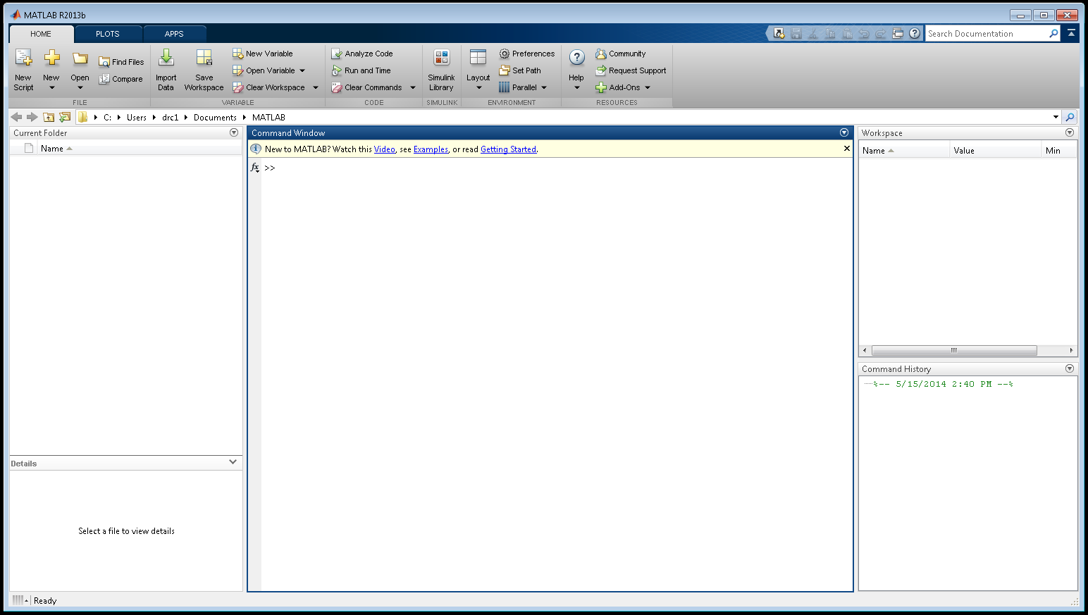
MATLAB Screen

Slide 7
Matrix Terminology
Scalar: a singular constant real number
Vector: a 1-Dimensional array of any singular data type
Matrix: a multi-Dimensional array of a singular data type
Element: Any one member of a vector or matrix
Array: General term for a matrix or vector
Variable: Symbolic name unique identifier that contains some type of data to be used

Slide 8
Basic Commands
=: used to define a variable
  >> x = 3
;: used to suppress the output of any command
clear: removes all variables from the workspace
clc: cleans the command window
close: closes any extra windows such as figure windows
clear and close can also have a modifier to perform on specific instances
EX: clear x will only remove the variable x from the workspace

Slide 9
Vectors
For most of the operations on vectors and matrices, the data type is unimportant and will be represented by a shape
Row vectors are input using square brackets [ ] with a space or comma between each element
  >>[1 2 3 4]
  ans = ans =
  1 2 3 4
Column vectors are input using square brackets [ ] with a semicolon between each element where we ant a new row
  >>[1;2;3;4]
  ans = ans =
  1
  2
  3
  4

Slide 10
Vectors
To create a vector that has a regular interval the colon operator can
be used
  >> 1:4
  ans =
  1 2 3 4
The default interval is 1 but can be specified
  >> 1:0.5:4
  ans =
  1.0000 1.5000 2.0000 2.5000 3.0000 3.5000 4.0000
There is also the function linspace(), which allows for more control
  >> linspace(a,b)
  Generates a vector of 100 linearly spaced points that starts at a and ends at b
  >> linspace(a,b,n)
  Generates a vector of n linearly spaced points that starts at a and ends at b
The function logspace() operates simmilarly but on the logrithmic scale

Slide 11
Matrices
The most basic matrix would be a 2D array containing both rows and columns
  >>[1 2 3 4; 5 6 7 8]
  ans = ans =
  1 2 3 4
  5 6 7 8
Matrices are always defined ROWxCOLUMN
The function size() will return the dimensions of the input matrix
  >> size([1 2 3 4; 5 6 7 8])
  ans =
  2 4
size() can also have a dimension specified, 1 for row, 2 for column
  >> size([1 2 3 4; 5 6 7 8],1) >> size([1 2 3 4; 5 6 7 8],1)
  ans = ans =
  2 4
columns
1
2
rows
1 2 3 4

Slide 12
Indexing
Often times you will want to select a specific element from a matrix
A =
The most common method is to call A(row, column) using the subscripted index
  >> A(1,3)
  ans =
You can also use the linear index
  >> A(7)
  ans =
The two can be exchanged with the sub2ind() and ind2sub() functions
  >> index = sub2ind(size(A),row,col) >> [row col] = ind2sub(size(A),index)
1,1
1,2
1,3
2,1
2,2
2,3
3,1
3,2
3,3
Note: the final index can be substituted for A(end)
1
4
7
2
5
8
3
6
9

Slide 13
Changing Values
Altering any element in a matrix works like assigning a variable
A =
You can also remove an element by assigning the desired index to be a blank vector [ ]. Note, unless you remove the entire row or column, you must use the linear index after which the resulting matrix becomes a row vector.
>> A(3) = []
  ans =
To remove the entire row or column you must select it in the removal assignment, which can be done with a colon :
  >> A(2,:)
  ans =
  >>A(1,3) =
  ans =

Slide 14
Matrix Addition
A = [ ]
B = [ ]
To add (or subtract) a single scalar to an entire matrix use the following syntax
  >> A + 2 = [( +2), ( +2), ( +2)]
To add two matrices together they must be the exact same dimensions or else an error will return. If they are, then the self same indices are added together and the resulting matrix is the same size as the two input.
>> C = A + B
C =
[( + ), ( + ), ( + )]
Two arrays can also be concatenated if they share a dimension
>> C = [A B] >> C = [A ; B]
C = C =

Slide 15
Matrix Multiplication
A = [ ]
B = [ ]
Multiplying (or dividing) a scalar to an array works just like addition of a scalar
  >> 3*A = [(3* ), (3* ), (3* )]
Multiplying two matrices is not as simple as just multiplying the elements together. The two matrices must have the column size of one match the row size of the other.
>> A x B
>> A x B’
It is also NOT commutative unlike multiplication for scalars. Order matters and the resulting matrix has the same number of rows as the first and the same number of columns as the second
  >> size(A*B’) >> size(B’*A)
  ans = ans =
  1 1 3 3
B’ =

Slide 16
Matrix Multiplication
A = [ ]
In matrix multiplication the elements of the rows of the first matrix are multiplied elementwise by the elements of the columns of the second matrix and then added together
  >> A*B’ = 1x3 * 3x1 = 1x1
  >> B’*A = 3x1 * 1x3 = 3x3
B’ =
* = (( * )+( * )+( * ) =
59
( * )
( * )
( * )
* =
( * )
( * )
( * )
( * )
( * )
( * )

Slide 17



Matrix Multiplication
A = [ ]
B = [ ]
Often we do not want to actually multiply two matrices but instead only multiply the corresponding elements. Note this can only be done between two matrices of the same size and results in a matrix of the same size as the multipliers
Elementwise multiplication and division are done by adding a period directly before the operator
>> C = A .* B
C =
[( * ), ( * ), ( * )]
This can also be used for powers and root functions
>> A.^2 >> B./(1/2)
[ ² , ², ²] [ , , ]

Slide 18
Useful Matrices
The Identity matrix eye() is a matrix that has 1s along the diagonal and 0s everywhere else. It has the property that multiplying it in front of another matrix will return the second matrix
  >> Ident = eye(3) >> Ident*A
  Ident = ans =
  1 0 0 A
  0 1 0
  0 0 1
The zeros() function creates a matrix comprised of nothing but 0s while the ones() function makes one that is nothing but 1s
>> zeros(2,4) >> ones(4)
ans = ans =
  0 0 0 0 1 1 1 1
  0 0 0 0 1 1 1 1
  1 1 1 1
  1 1 1 1
All of these functions can be called either with a single number (n), which will result in a square matrix of size nxn, or by specifying the dimensions with two numbers (n,m) creating a nxm matrix

Slide 19
Matrix Manipulation
Transposing matrices causes the rows and columns to be exchanged
To transpose a matrix the transpose() function can be used. Alternatively adding an apostrophe (‘) after an array will also transpose it
  >> A = [1 2 3;4 5 6;7 8 9]
  ans =
  1 2 3
  4 5 6
  7 8 9
You may also want to just flip a matrix over the horizontal or vertical axis
  >> flipud(A)
  ans =
  7 8 9
  4 5 6
  1 2 3
  >>transpose(A)
  ans =
  1 4 7 2 5 8
  3 6 9
  >>fliplr(A)
  ans =
  3 2 1 6 5 4
  9 8 7

Slide 20
Matrix Manipulation
A = [ ]
Reshaping a vector into a matrix is also useful for some operations
Reshaping is done via the reshape(A,n,m) command
  >> reshape(A,2,2)
  ans =
Note that the new matrix size must have the same total number of elements as the old one
To sort the elements of your matrix use the sort(A,dim) command
  >> S = [1 54 17;42 98 77; 23 36 69];
  >> sort(S)
  ans =
  1 36 17
  23 54 69
  42 98 77
If no specified dimension is selected it sorts based on columns and will affect all columns
To sort all of the elements but preserve the rows use sortrows()
A =

